Slide 1
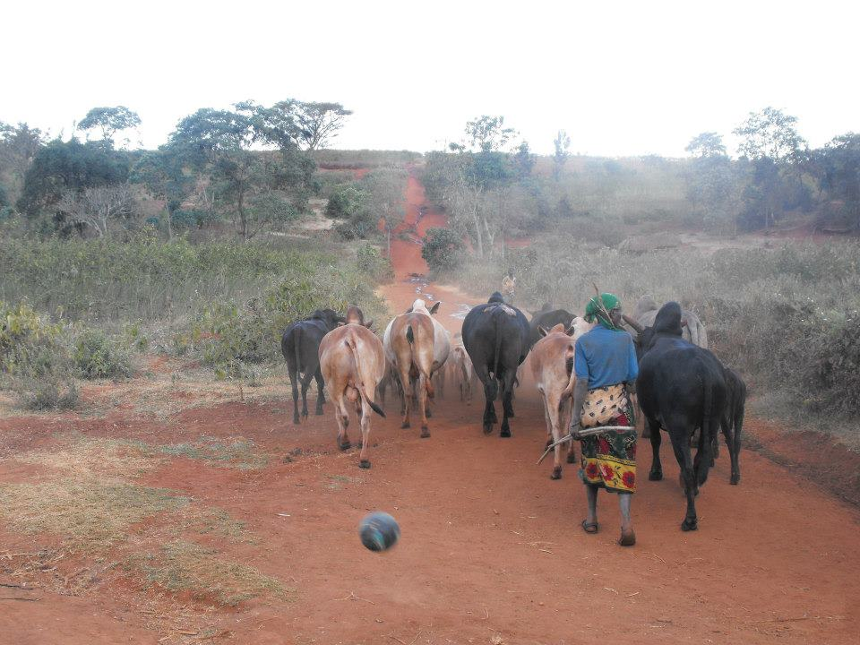

PARLIAMENTARY RESEARCH PRESENTATION
Tanzania Livestock Policy
Implementation status and sector outcomes to 2025
Parliamentary research presentation | Evidence review, not an official parliamentary position

Slide 2
The evidence supports a mixed, uneven assessment
76.9%
WEAK
NOT PROVEN
7.65 million agricultural households kept livestock in 2024/25.
Advisory reach, productivity and milk-market conversion.
No consolidated, time-bound scorecard links policy, budgets and outcomes.
Conclusion: partial and uneven performance; policy causation is not established.
English and Kiswahili assessment reports; NBS AASS 2024/25
02 / 24

Slide 3
What this review can—and cannot—establish
1
Reviews the 2006 National Livestock Policy against supplied NBS evidence.
2
Latest observation covers 1 Oct 2024–30 Sep 2025; report released Oct 2026.
3
AASS measures reported participation, stocks, output, practices and information access.
Evidence boundary
Retrospective 2025 outcomes ≠ data available to decision-makers during 2025.
Not an expenditure audit or impact evaluation. • No causal attribution to the 2006 policy. • No inference of real GDP growth from current-price shares.
AASS 2022/23–2024/25; both generated assessment reports
03 / 24

Slide 4
The 2006 policy is broad; measurable targets are not
Production and breeds
Animal health and veterinary services
Feed, pasture, water and rangelands
Research, training and extension
Markets, processing and infrastructure
Finance and coordination
The supplied policy text sets objectives and roles, but no dated national targets for productivity, extension, sales or expenditure.
National Livestock Policy (2006), printed pp. 3–4, 8–43
04 / 24

Slide 5
Delivery depends on a chain of public and local actors
POLICY
MINISTRY
LOCAL AUTHORITIES
HOUSEHOLDS & VALUE CHAINS
National objectives
›
Plans, standards, oversight
›
Front-line delivery
›
Services, production, markets
Policy assigns planning and monitoring responsibilities; implementation evidence and expenditure records were not supplied.
National Livestock Policy (2006), printed pp. 44–49
05 / 24

Slide 6
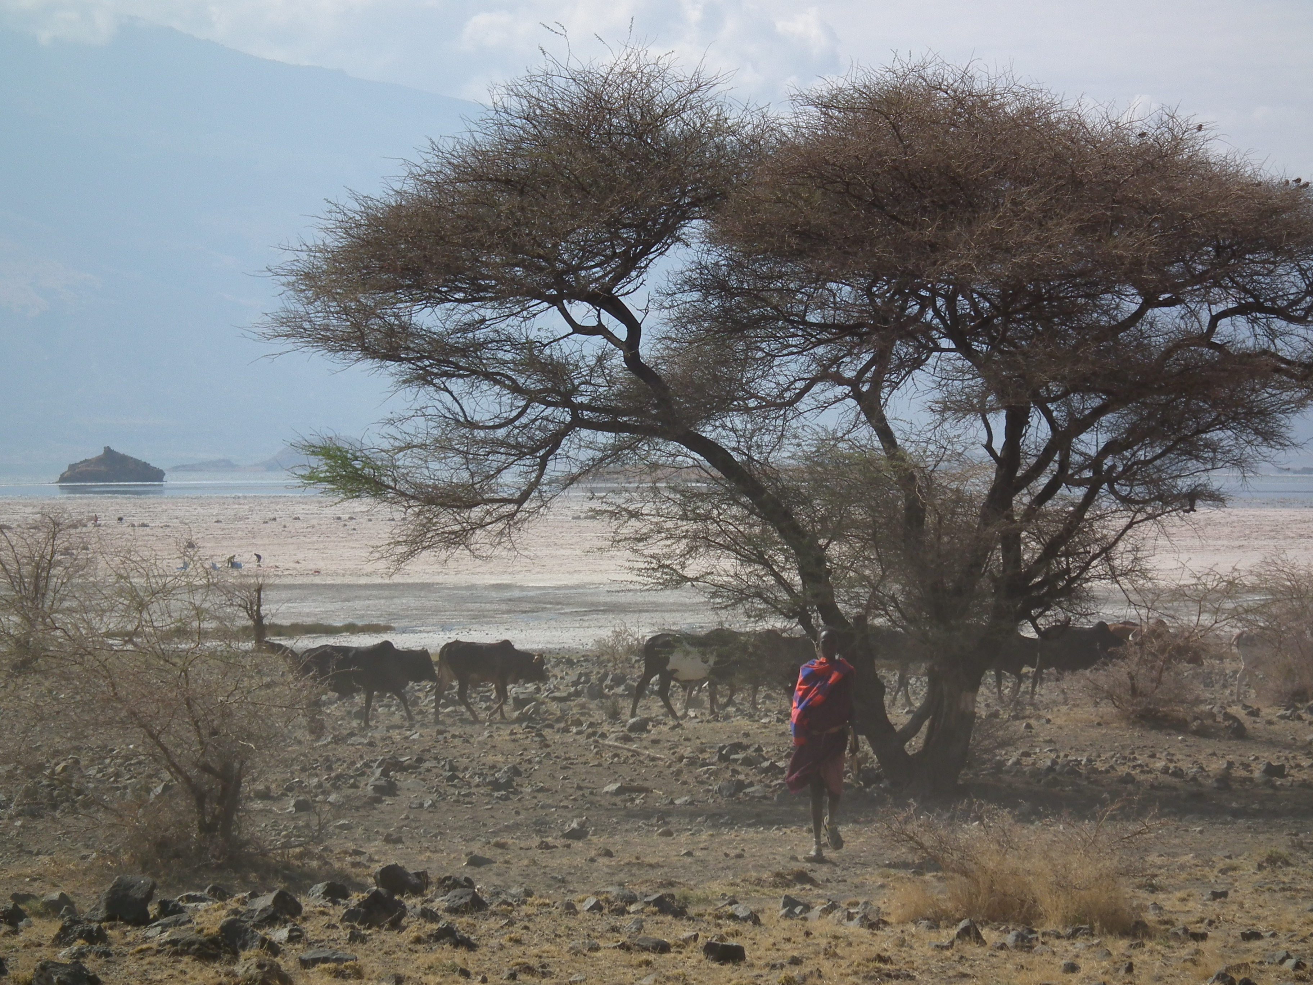
Livestock keeping is widespread—but the series needs reconciliation
7.65m
76.9%
40.76m
livestock-keeping agricultural households
reported participation in 2024/25
cattle estimated at 1 Oct 2025
AASS participation: 60.6% (2022/23), 57.3% (2023/24), 76.9% (2024/25). Do not read the jump as a policy effect without a comparable-series note.
NBS AASS 2022/23, 2023/24 and 2024/25
06 / 24

Slide 7
Reported participation rose sharply in 2024/25
Agricultural households reporting livestock keeping (%)
2022/23
60.6%
2023/24
57.3%
2024/25
76.9%
The 19.6 percentage-point rise from 2023/24 is unexplained in the supplied reports; no trend or policy attribution is made.
NBS AASS 2022/23–2024/25
07 / 24

Slide 8
The livestock base is large and overwhelmingly household-raised
Estimated stock at 1 October 2025 (millions)
Cattle
40.76
Goats
28.38
Sheep
10.24
Pigs
3.74
Chickens
113.59
Households accounted for 99.8% of cattle, 99.9% of goats, sheep and pigs, and 96.2% of chickens.
NBS AASS 2024/25, livestock estimates at 1 Oct 2025
08 / 24

Slide 9
Milk yield differs markedly by cattle type
Average litres per cow per day
Indigenous · dry
1.6 L
Indigenous · wet
2.3 L
Improved · dry
12.9 L
Improved · wet
13.2 L
Improved-cow yield was about 8.1× indigenous in the dry season and 5.7× in the wet season. These differences do not isolate breed as the sole cause.
NBS AASS 2024/25, cattle and milk productivity
09 / 24

Slide 10
Production is substantial; reported milk sales are limited
4.2bn L
AASS milk output in 2024/25
29% reported sold
71% not reported sold
The survey does not separate household use, informal trade, processing, storage or other destinations for the balance.
NBS AASS 2024/25
10 / 24

Slide 11
Reported information access is low—and one denominator is unclear
Share of agricultural households / holdings reporting access (%)
Livestock information*
8.9%
Market & price information
14.3%
Weather information
44.8%
*683,922 holdings; 8.9% implies a livestock-keeper denominator, while the displayed total-holdings denominator gives ~6.9%. NBS clarification is needed.
NBS AASS 2024/25, livestock information and access tables
11 / 24

Slide 12
Extensive feeding remains dominant for indigenous stock
Extensive feeding reported
Intensive feeding reported
Indigenous cattle
84.1%
Improved cattle
66.1%
Indigenous goats
79.8%
Improved chickens
59.5%
Indigenous chickens
69.2%
Feeding systems should be assessed against local resources and seasonal needs; extensive practice is not automatically unsuitable.
NBS AASS 2024/25, feeding systems
12 / 24

Slide 13
Livestock’s current-price GDP share has declined since 2021
Livestock share of Tanzania Mainland GDP (%)
2021
7.4%
2023
7.3%
2024
7.1%
2025
6.7%
2025 value: TZS 15.689 trillion at current market prices. Share movement is not a real-output series and is not proof of policy impact.
NBS Statistical Abstract 2025, Tables 5.4 and 5.6
13 / 24

Slide 14
Climate exposure and participation gaps warrant targeted scrutiny
61.8%
7.2 pp
78.7% vs 71.5%
of agricultural households reported drought / erratic rainfall
gap in livestock participation by household-head sex
male- vs female-headed agricultural households
The climate figure is agriculture-wide, not livestock-specific. The participation gap alone does not establish unequal service access or benefits.
NBS AASS 2024/25
14 / 24

Slide 15
A measurable scorecard shows uneven performance
Policy outcome
Evidence-based judgement
Household participation / scale
Mixed; series not reconciled
Productivity / intensification
Weak / not demonstrated broadly
Extension / information
Weak; reach gap observed
Commercialisation
Partial; ~29% of milk reported sold
Economic contribution
Material; relative share lower than 2021
Governance / monitoring
Not demonstrated in supplied record
Sector scale is not proof of policy effectiveness. Ratings distinguish observed conditions from attribution.
English and Kiswahili assessment reports; NBS AASS and Statistical Abstract
15 / 24

Slide 16
Several major policy outcomes remain unverified
UNVERIFIED
Animal health
UNVERIFIED
Poverty & food security
Staffing, vaccination, disease prevalence, outbreak response
No causal household or national impact measure
UNVERIFIED
Infrastructure & finance
UNVERIFIED
Environment & conflict
No complete coverage, functionality or spending series
No outcome series adequate for a policy rating
Unverified is not the same as failed; administrative, audit and evaluation evidence is needed.
Supplied policy and AASS reports; assessment limitations
16 / 24

Slide 17
Analytical framework: convert observed gaps into testable delivery questions
OBSERVED CONDITIONS
CHECK DELIVERY
TEST RESULTS
Low advisory reach\nLow milk sales\nExtensive feeding
›
Who received services?\nWhere and how often?\nWhat was funded?
›
Productivity by system\nMarket volumes / prices\nEquity and resilience
Proposed analytical framework—not an officially adopted Government framework. Correlation is not causal proof.
Proposed analytical framework based on assessment findings
17 / 24

Slide 18
Four proposed workstreams address the documented shortfalls
1 Reach
2 Productivity
District-, sex- and species-disaggregated extension plans
Dry-season feed, pasture, water and husbandry support
3 Markets
4 Assurance
Collection, cooling, quality, processing and marketed volumes
Veterinary coverage, surveillance, budgets and public reporting
These are proposed parliamentary follow-up areas, not adopted Government programmes.
Proposed parliamentary follow-up based on the assessment
18 / 24

Slide 19
A stronger accountability loop would connect plans to results
SET
DELIVER
REPORT
VERIFY
RESPOND
Dated targets & costs
›
Named institutions & coverage
›
Quarterly / annual actuals
›
NBS, audit & evaluation
›
Committee follow-up & corrective action
Proposed accountability cycle; the supplied record does not show a consolidated system currently in operation.
Proposed framework; policy implementation and monitoring provisions
19 / 24

Slide 20
Use published baselines first; set targets only after validation
Policy outcome
Evidence-based judgement
Extension / livestock information
8.9%*; denominator to clarify
Market information access
14.3% reported
Milk marketed
~29% of output reported sold
Participation by household-head sex
78.7% male / 71.5% female
Livestock GDP share
6.7% at current prices, Mainland, 2025
Proposed dashboard indicators. Confirm definitions, coverage, cost and baseline quality before adopting annual targets.
NBS AASS 2024/25; NBS Statistical Abstract 2025
20 / 24

Slide 21
A 12-month scrutiny roadmap can sequence corrective action
MONTHS 0–3
Reconcile AASS denominators and participation series; submit policy commitment inventory.
MONTHS 4–6
Cost the delivery plan; publish veterinary, extension and market baselines.
MONTHS 7–9
Report district coverage, seasonal feed/water readiness and market performance.
MONTHS 10–12
Review results, audit gaps and corrective actions; propose policy refresh if needed.
Proposed sequencing for parliamentary follow-up; it is not an approved Government implementation timetable.
Proposed 12-month parliamentary follow-up
21 / 24

Slide 22
Mitigate measurement, delivery and equity risks
Incomparable survey estimates
NBS comparability note; publish definitions and confidence intervals.
Targets without budgets
Cost targets; report allocations, releases and expenditure.
Seasonal shocks
Track dry-season feed and water access, not only infrastructure counts.
Unequal reach
Disaggregate services and results by sex, district and production system.
Risk controls are proposed safeguards; the available sources do not quantify their cost.
Assessment findings and proposed safeguards
22 / 24

Slide 23
Decision message: measure delivery before claiming success
1
The sector is large and economically material—but scale is not policy impact.
2
Observed weaknesses are specific: advisory reach, productivity, market conversion and monitoring.
3
NBS must clarify key series and denominators before performance comparisons.
4
Parliamentary follow-up should demand costed targets, disaggregated results and verification.
Evidence-led scrutiny can distinguish policy commitments, delivery and outcomes.

Slide 24
Sources and evidence trail
1
National Livestock Policy (2006), printed pp. 3–4, 8–49.
2
NBS AASS 2022/23 National Report, Sep 2024; participation and survey frame.
3
NBS AASS 2023/24 National Report, Sep 2025; participation and survey frame.
4
NBS AASS 2024/25 National Report, Oct 2026; livestock, milk, feeding, water, shocks and information.
5
NBS Statistical Abstract 2025, Sep 2026; Mainland GDP and livestock products.
6
Tanzania Livestock Policy Assessment to 2025 (English and Kiswahili), supplied analytical reports.
The 2024/25 AASS was published after its reference period. This presentation is an analytical product, not an official Parliament resolution.
Source citations are listed in References_and_Sources.xlsx
24 / 24

